Slide 1
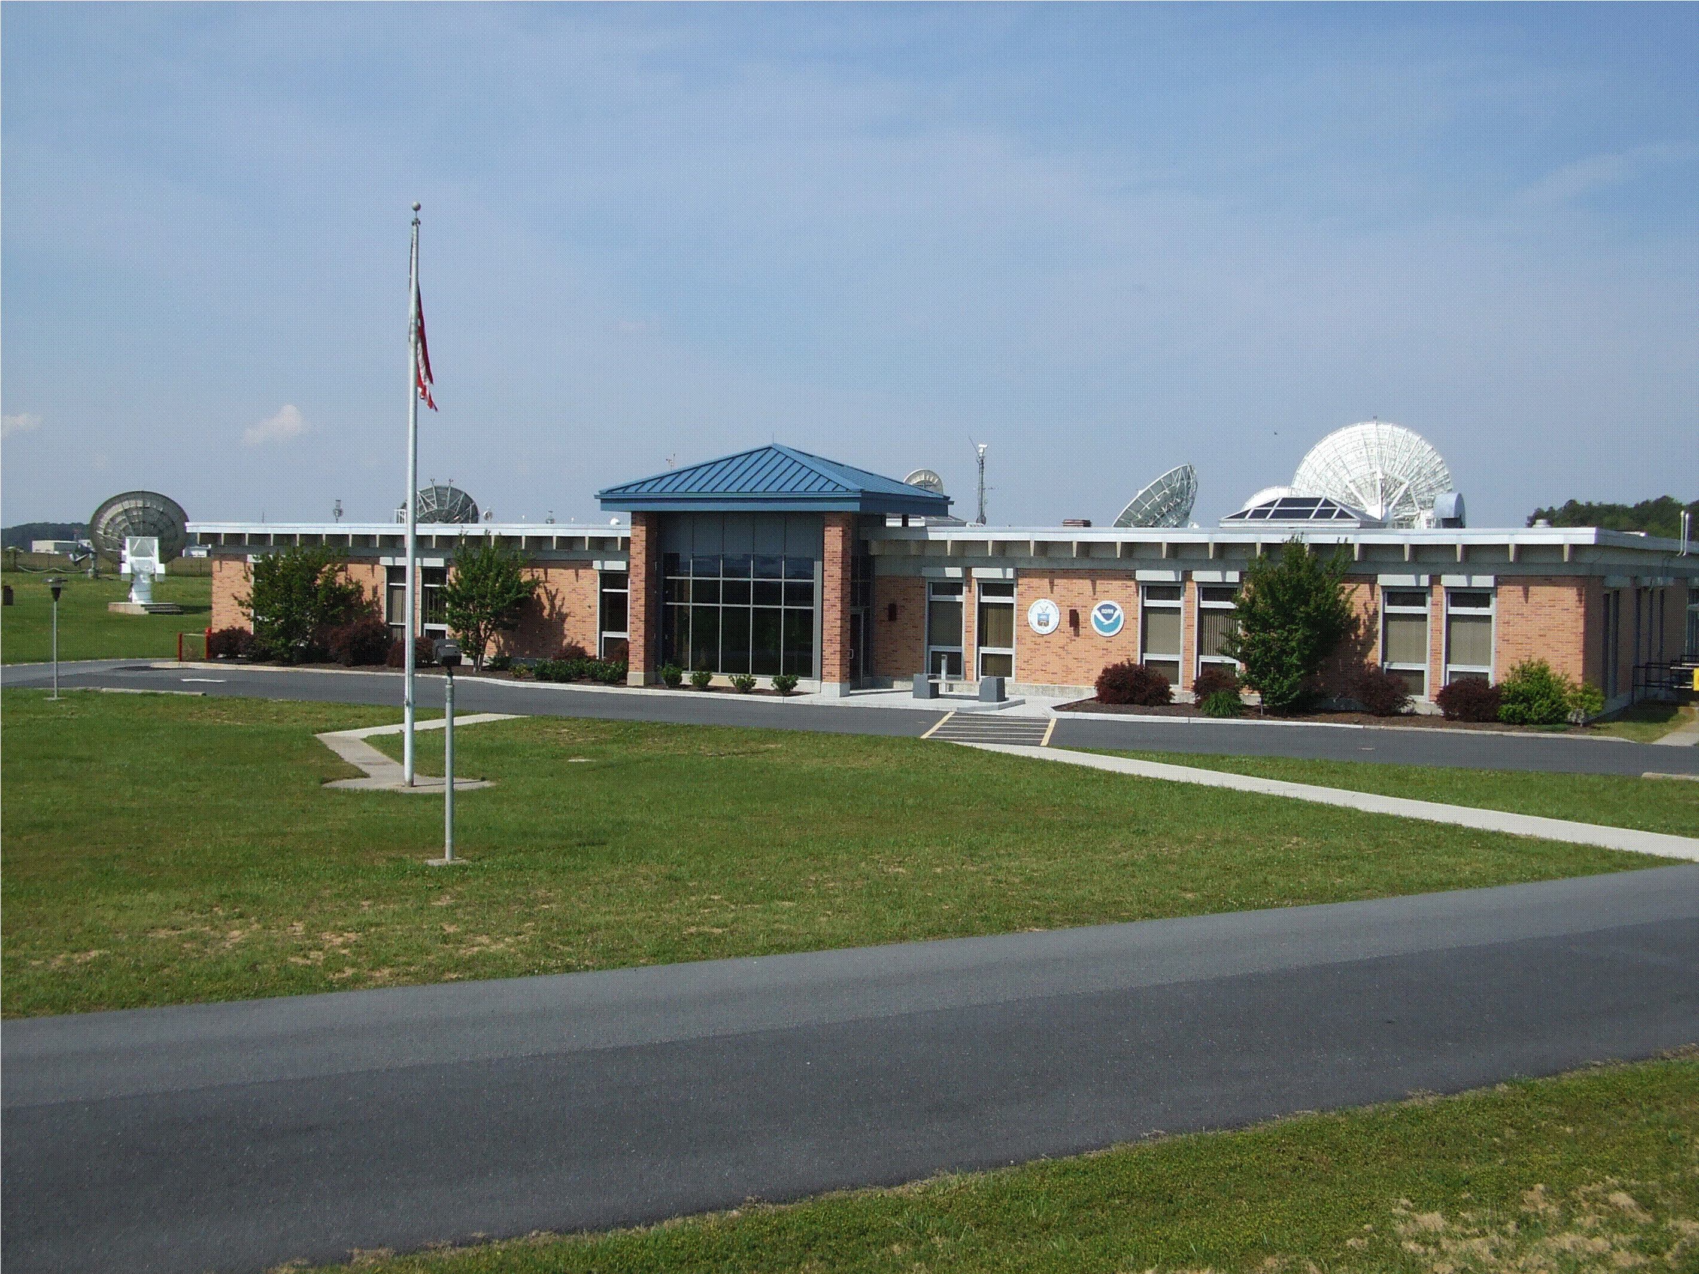

Slide 2
Spacecraft Constellation
GOES-12 scheduled for de-commissioning in Dec 2013
  GOES-12 still supporting South American mission
  GOES-12 DCS is turned on
  No decision on South American support after Dec 13
GOES-13 is prime East S/C @ 75 deg West
GOES-15 is prime West S/C @ 135 deg West
GOES-14 is in storage @ 105 deg West
GOES-11 was de-commissioned 15 Dec 2011
GOES-3 was de-orbited Mar 2012

Slide 3

DCS
DADDS on-line since Jan 2010.
IT Security Authorization and Accreditation completed on Mar 31 2012
  We have a 1 year Authority To Operate
  This includes the WCDAS and the NSOF
Four of the six test transmitters have been upgraded to the new crystal oscillators
New RSS news feed link on the DCS web sites to provide DCS status updates.

Slide 4
DCS Continued
NWSTG TCP/IP data currently being transferred from both WCDAS and NSOF. No more X.25.
  This gives NWS capability to chose source
Lowered AGC lock threshold on all demodulator cards from 30dBm to 25dBm.
  Analysis shows the lowered threshold will yield approx. 2500 more messages per day.

Slide 5
Wallops LRGS Configuration
No real changes to the LRGS configuration since the last meeting
NOAA staff builds accounts and shares these with USGS/EDDN
Customers can get LRGS client S/W and manual at:
  http://dcs1.noaa.gov
  http://dcs2.noaa.gov
Sites and IP’s for CDADATA, CDABACKUP and DROT:
  http://cdadata.wcda.noaa.gov (205.156.2.174)
  http://drot.wcda.noaa.gov (205.156.2.186)
  http://cdabackup.wcda.noaa.gov (205.156.2.189)
  Use drot to troubleshoot (this is the DOMSAT downlink as seen at Wallops).
  cdadata & cdabackup are sharing data with EDDN

Slide 6
LRIT Status
Internal latency tests were conducted jointly with NOS in Feb (this will be discussed further during the meeting).
Wallops is working with SSD (Satellite Services Division) to use the backup at Wallops during periods of outages.
The SSD LRIT failover at Wallops remains manual
  Tested week of April 16
  SSD staff in Suitland can activate remotely

Slide 7
LRIT
LRIT benefits
  1 meter antenna receives full LRIT stream
  There are no re-occurring costs associated with LRIT reception.
  GOES coverage = LRIT coverage

Slide 8
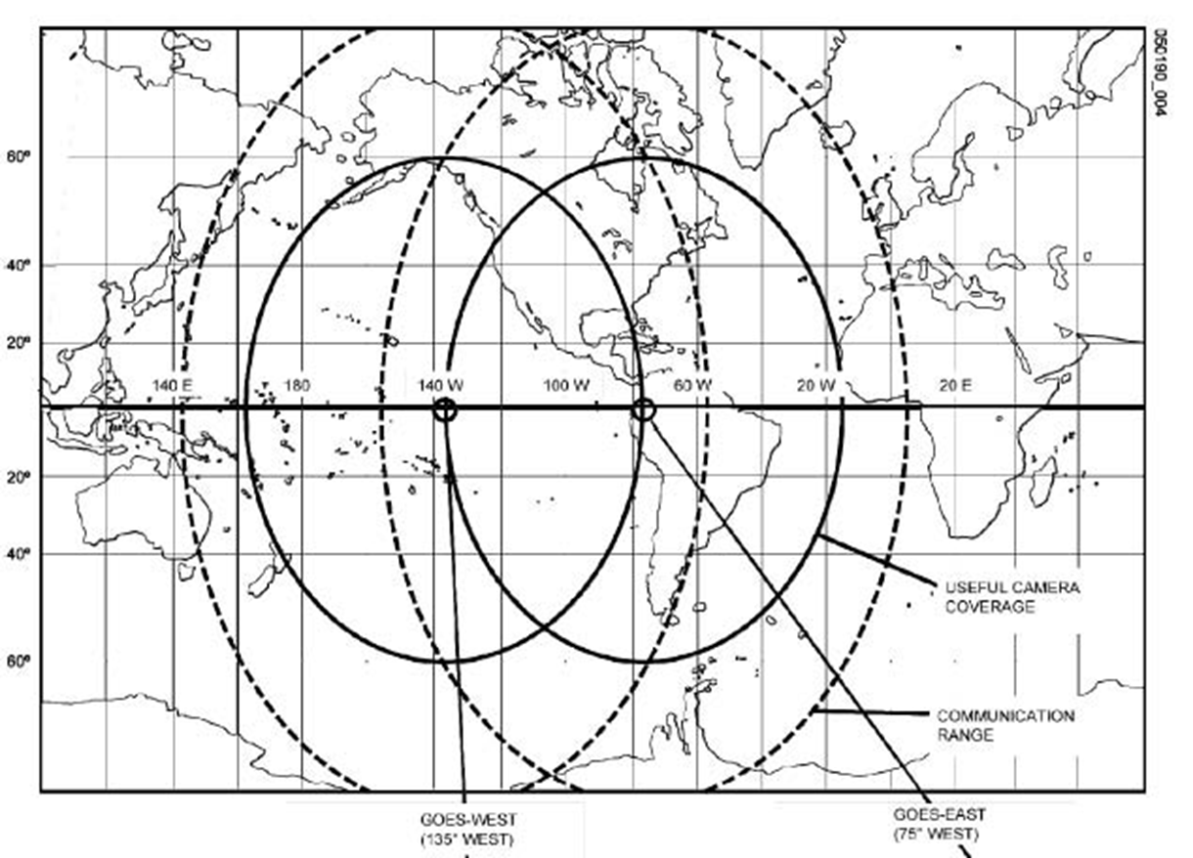
GOES Footprint

Slide 9
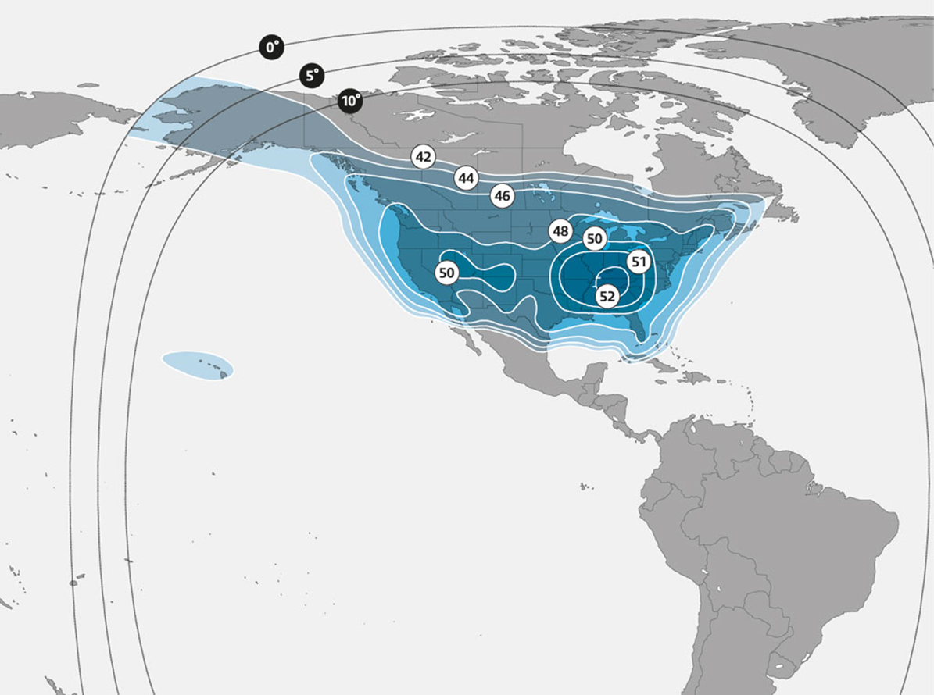
SES-1 Ku-Band Footprint

Slide 10
DOMSAT Status
Recent DOMSAT failover attempts have been rough
Equipment upgrades expected with the new contract

Slide 11
Current DOMSAT Configuration
Frequency change on SES 1 – 16 Dec 2011
GOES DCS DOMSAT Service
Current Satellite, SES-1
Located at 101deg West
Ku Transponder 14
New Frequency 11997.525 MHz (Old Frequency 11987.2MHz)
Horizontal Polarization

Slide 12
WCDAS Equipment Moves
Major components of the DCS system at Wallops will be relocated during the week of May 15 (Travis is the lead) to make room for GOES-R equipment and facility upgrades.
WCDAS is planning a failover test to NSOF for DOMSAT and NWS services during week of May 7th.
Anticipating two days of WCDAS outages during the move.
DOMSAT and NWSTG feeds will be from NSOF
No Wallops LRGS availability during this period
Please check the DCS bulletins, RSS feed, or call the 24/7 number to get system status concerning the move.
All equipment moves are contingent on critical weather day declarations (these can be declared suddenly)

Slide 13
WCDAS Equipment Moves
The DCS pilot antennas located on the Wallops Operations Building will be moved to new location mid/late Summer 2012.
During the move process, we will use the Wallops Backup (Goddard) pilot.
No planned interruption to users.
Ultimately three new 4-meter directional antennas will be installed to be the permanent pilot antennas.
This upgrade will be in the Fall 2012 depending on:
  OSD/Procurement priorities
  Construction schedule

Slide 14
Wallops Backup
A second pilot remains active (channel 0) at the WBU. The frequency is 401.7MHz.
LRIT and EMWIN equipment is at WBU & FCDAS still waiting for connectivity to NSOF – multicast issue.

Slide 15
Test Channels
GOES East
  300bps
    195E for CS1 & CS2 (401.99200 MHz)
  1200bps
    A99 for CS1, 497 for CS2 (401.99575 MHz)
      Incompatible with CS2-needs to move
  100/300 bps Auto Detect
    151E CS1 Only (401.9260 MHz)
GOES West
  300bps
    196W for CS1 & CS2 (401.99350 MHz)
  1200bps
    A100 for CS1, 499 for CS2 (401.99875 MHz)
  100/300 bps Auto Detect
    151E CS1 Only (401.9260 MHz)

Slide 16
Misc. From Last Meeting (Phil)
(Points for discussion)
NESDIS review of binary data usage: Assigned to Philip, Warren, Peter. Philip reviewed the vendor proposals and forwarded comments and recommendations to Warren, Nov or Dec.
LRGS Source code: Assigned to Warren (from NOS) & Philip: Warren & Philip agree that the LRGS source code (the old "FF") would be most useful if it could be used as a "value added" stamp for all DRGS, LRGS, LRIT, etc. paths.

Slide 17
Misc. From Last Meeting (Phil)
Philip to Provide drawing of the DADDS & interconnections: Work in progress.

Slide 18
GOES-R WCDAS Construction Update

Slide 19
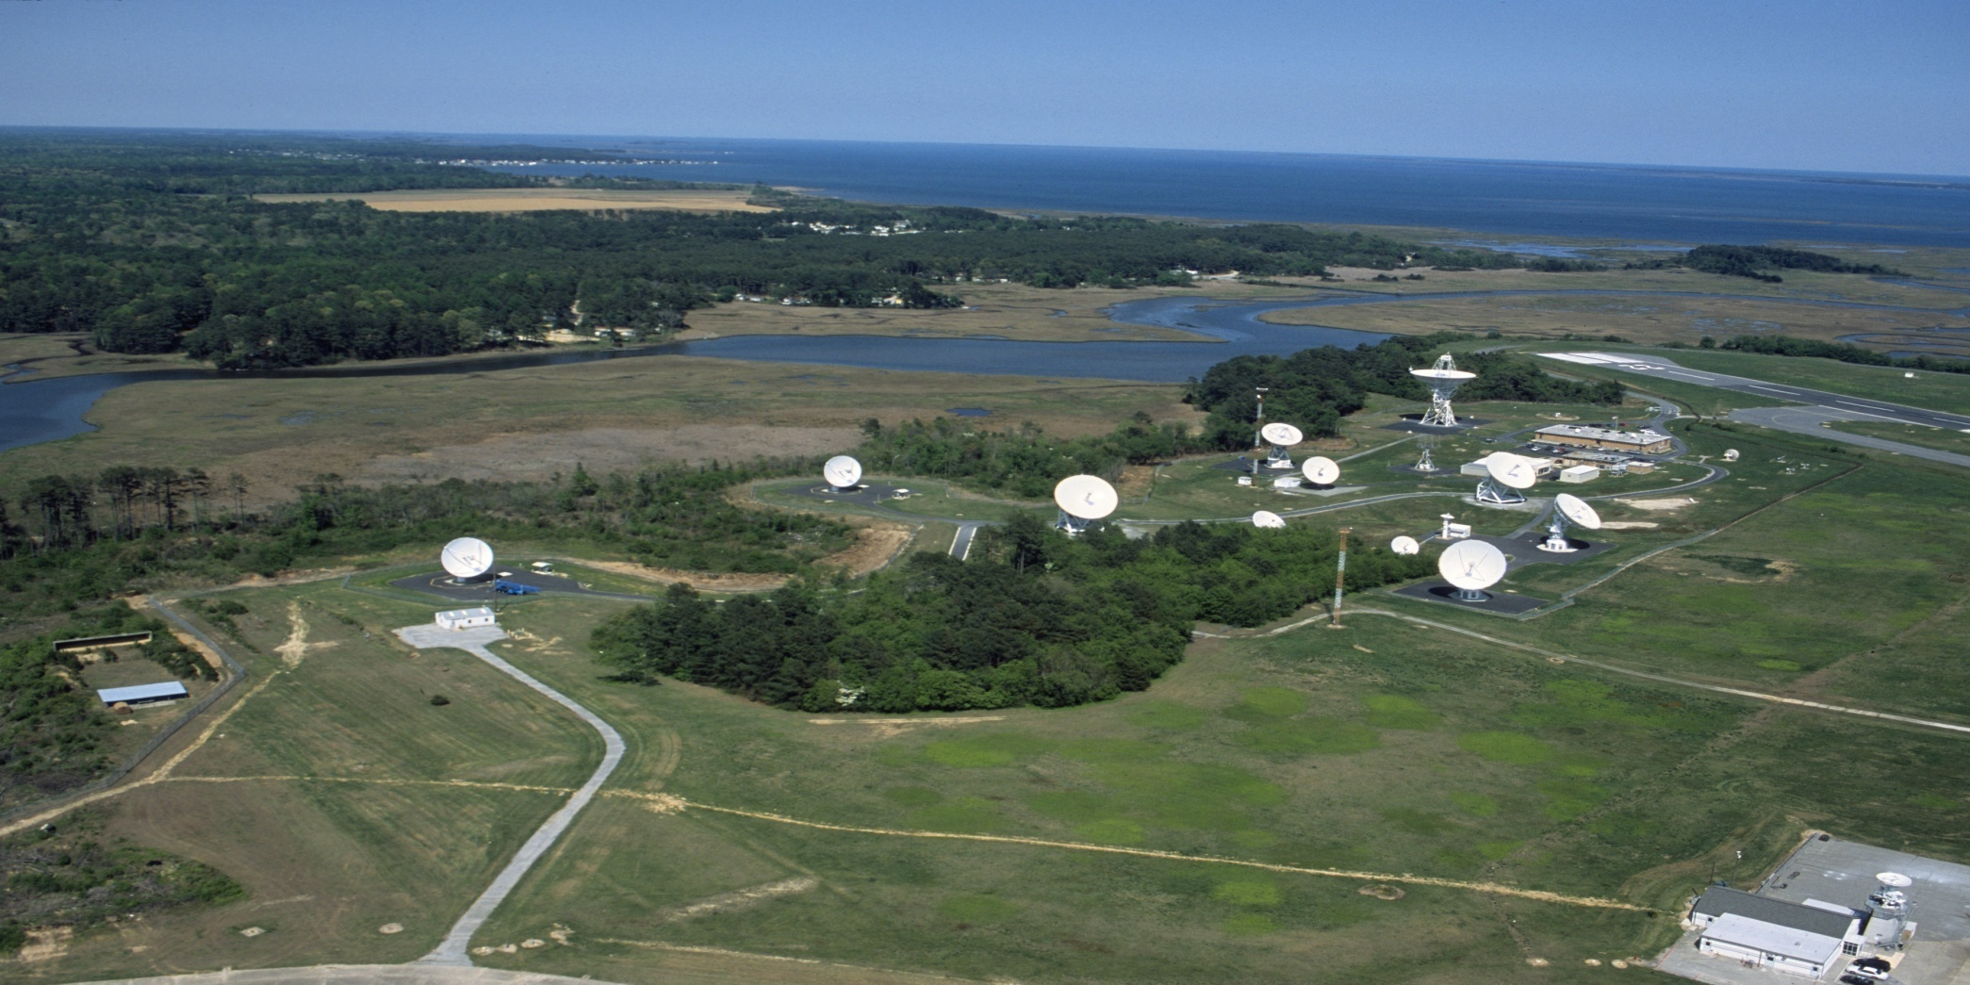
NOAA COMMAND AND DATA ACQUISITION STATION
(Prior to GOES-R construction)

Slide 20
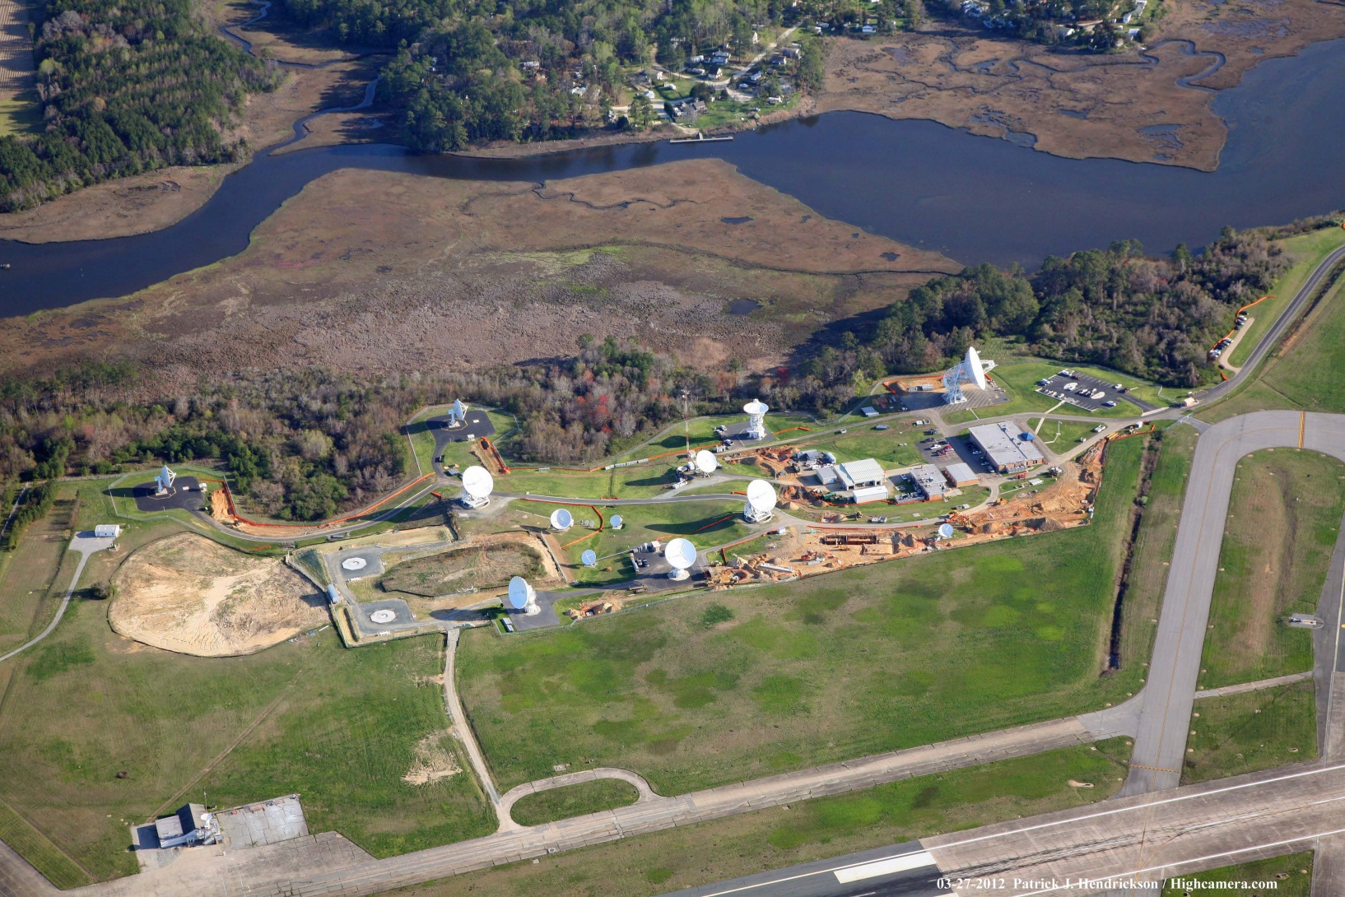
Current Aerial WCDAS View

Slide 21
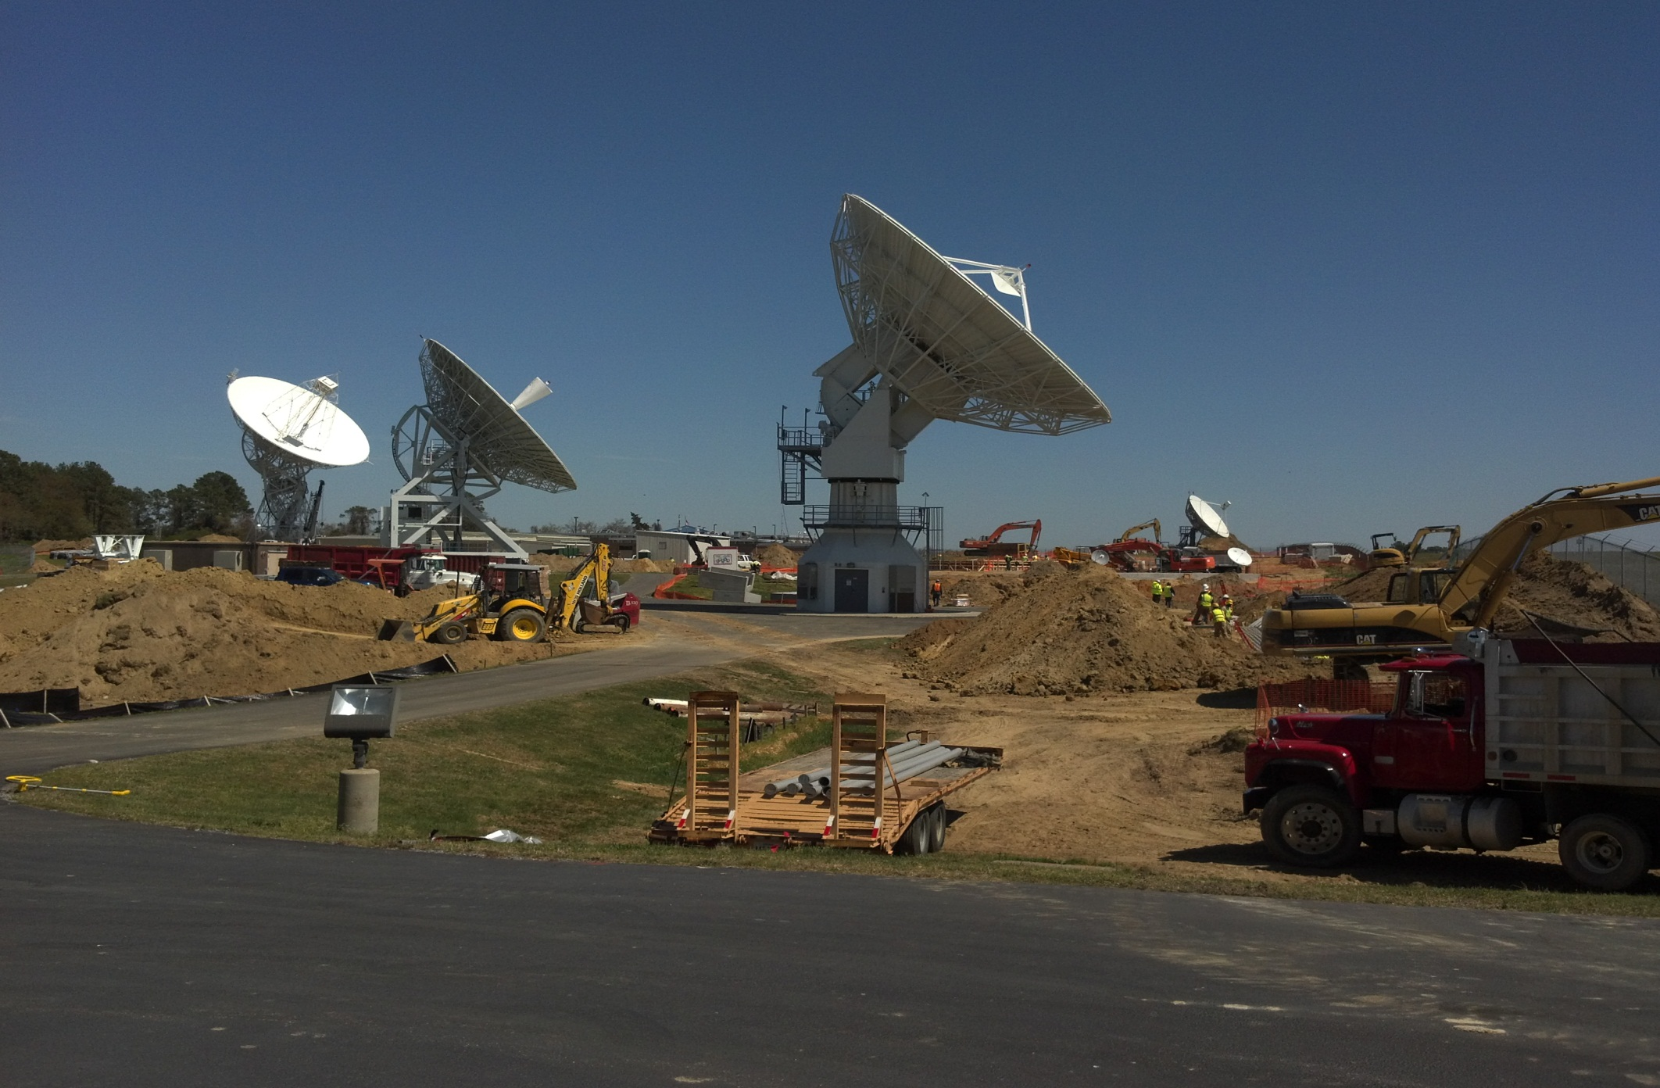

Slide 22
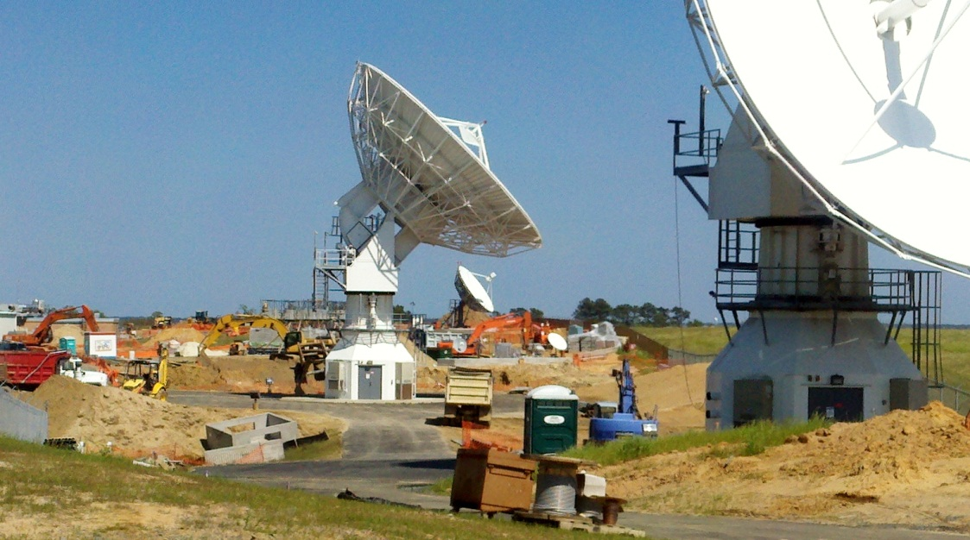

Slide 23
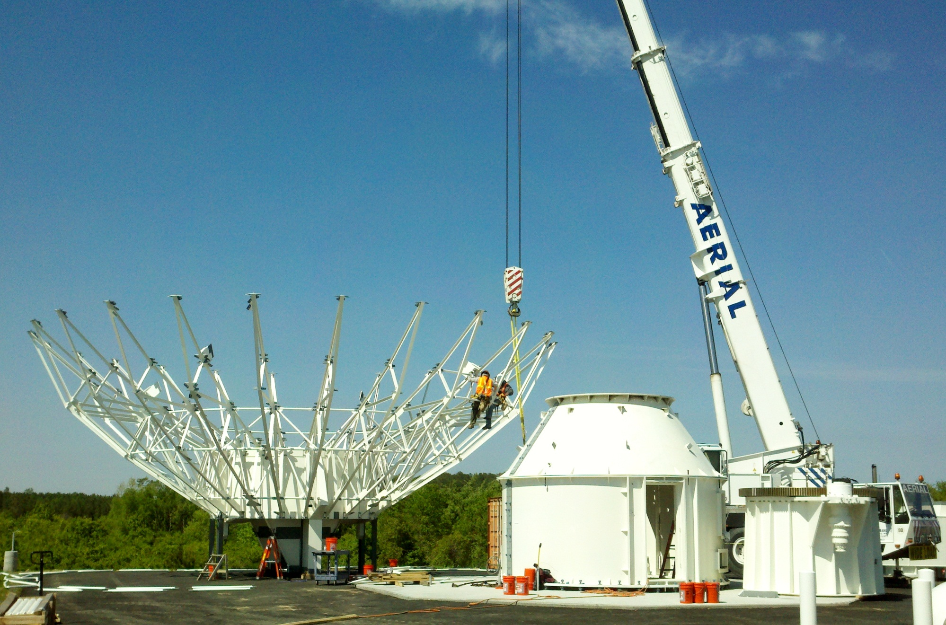

Slide 24
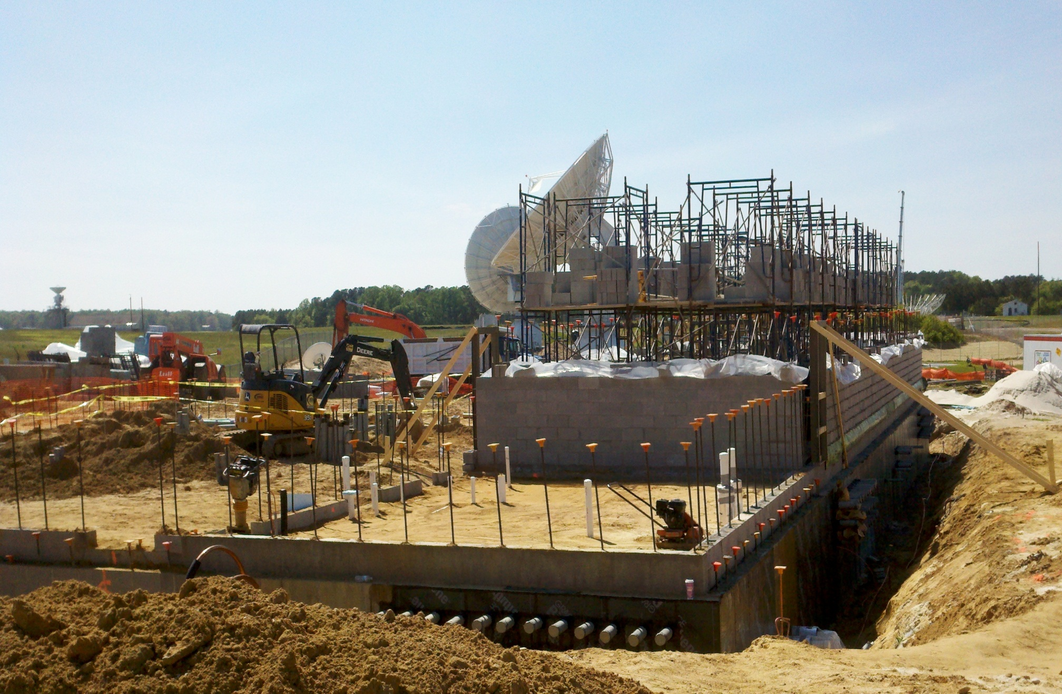

Slide 25
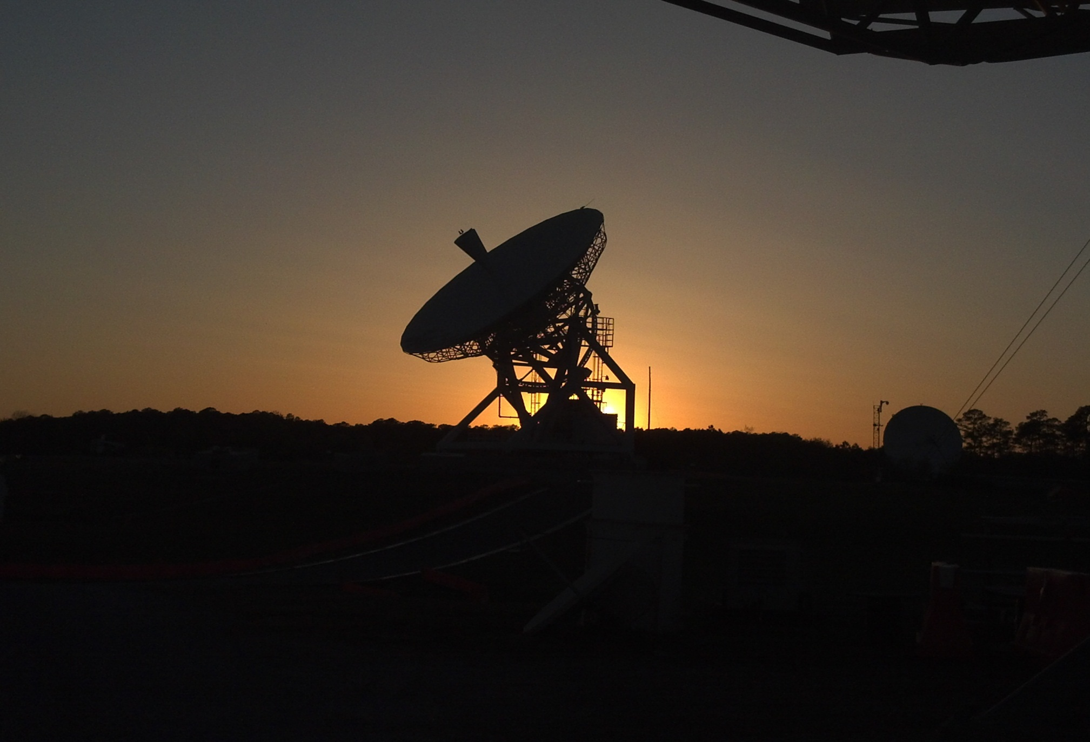

Slide 26
Informational NESDIS Phone Numbers
DCS Help Desk at 757-824-7450 or 7451
    For 24/7 Technical Help
Travis Thornton (Team Lead) 757 824-7450
Kay Metcalf (Program Manager) 301 817-4558
Letecia Reeves (Customer Service) 301 817-4563
Phil Whaley (RF/Engineering) 757 824-7331
Al McMath (Operations Manager) 757 824-7316

