Slide 1
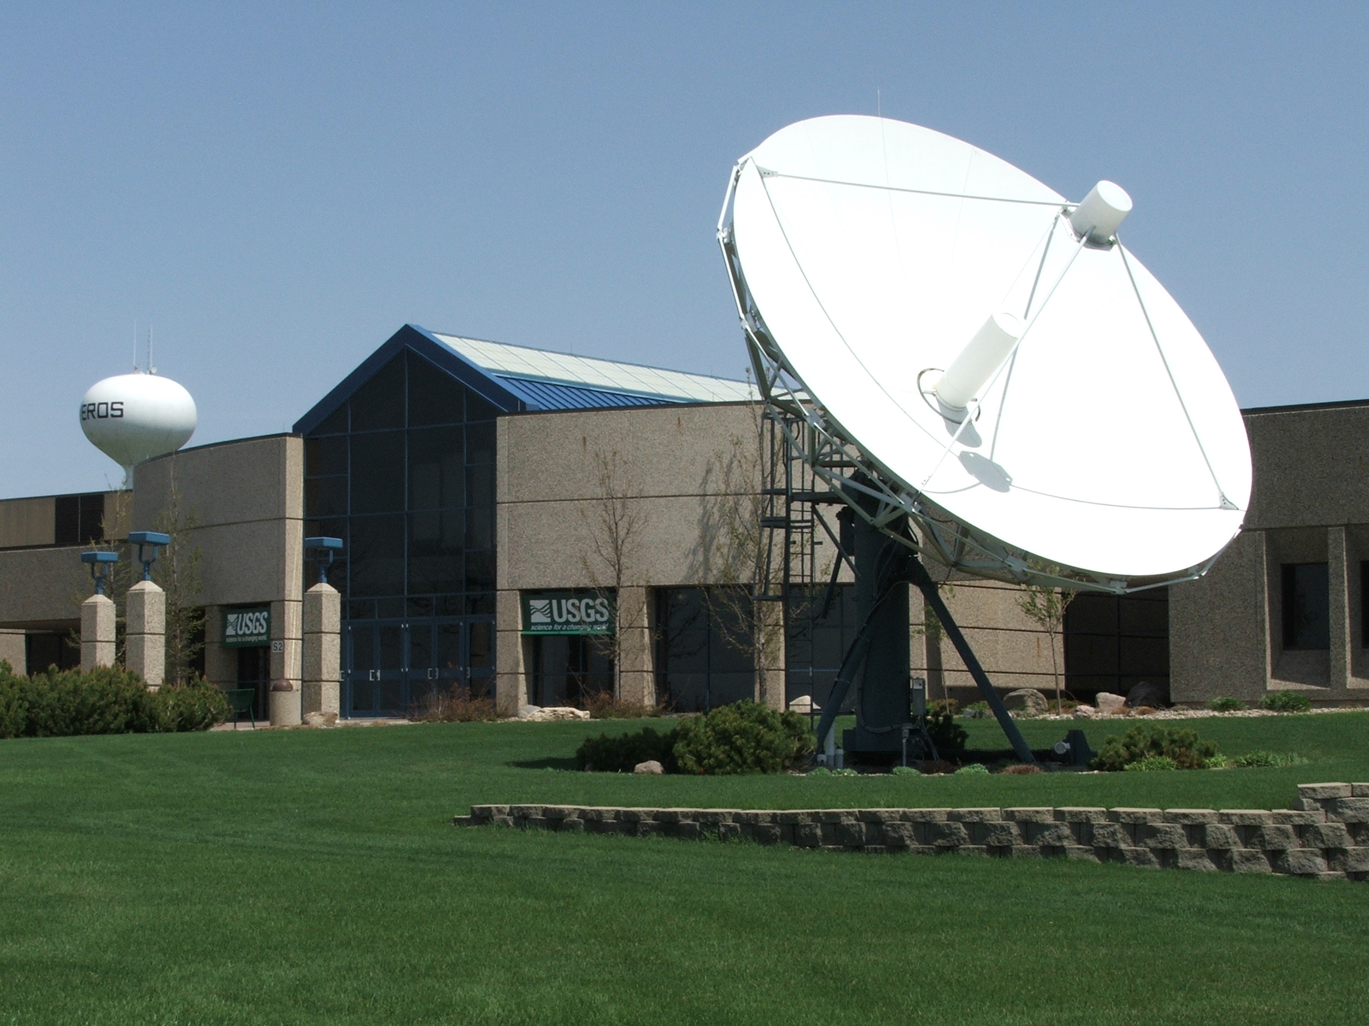
GOES DCS Status and Information
Dan Schwitalla – ddschwit@usgs.gov
2009 111th Meeting of the STIWG– 18 – 20 May 2009

Slide 2
Agenda
Background and status of the EDDN
New GOES Data Tools
Future products and enhancements

Slide 3
EDDN Project GOALS
Receive data from all DCPs transmitting in the GOES DCS independently of Wallops Island.
Locate satellite downlink at a receive site(s) sufficiently distant from Wallops Island to achieve event independence.
Distribute data independently of Wallops Island.

Slide 4
Basic EDDN System
Satellite downlink system with 2 antennas for GOES East and West ( at least 7M )‏ and one backup antenna
DOMSAT receive system for data from Wallops Island
LRGS systems for acquiring and distributing data.
Web Server for reporting system status.

Slide 5
8.1M Antenna at EROS for GOES East

Slide 6
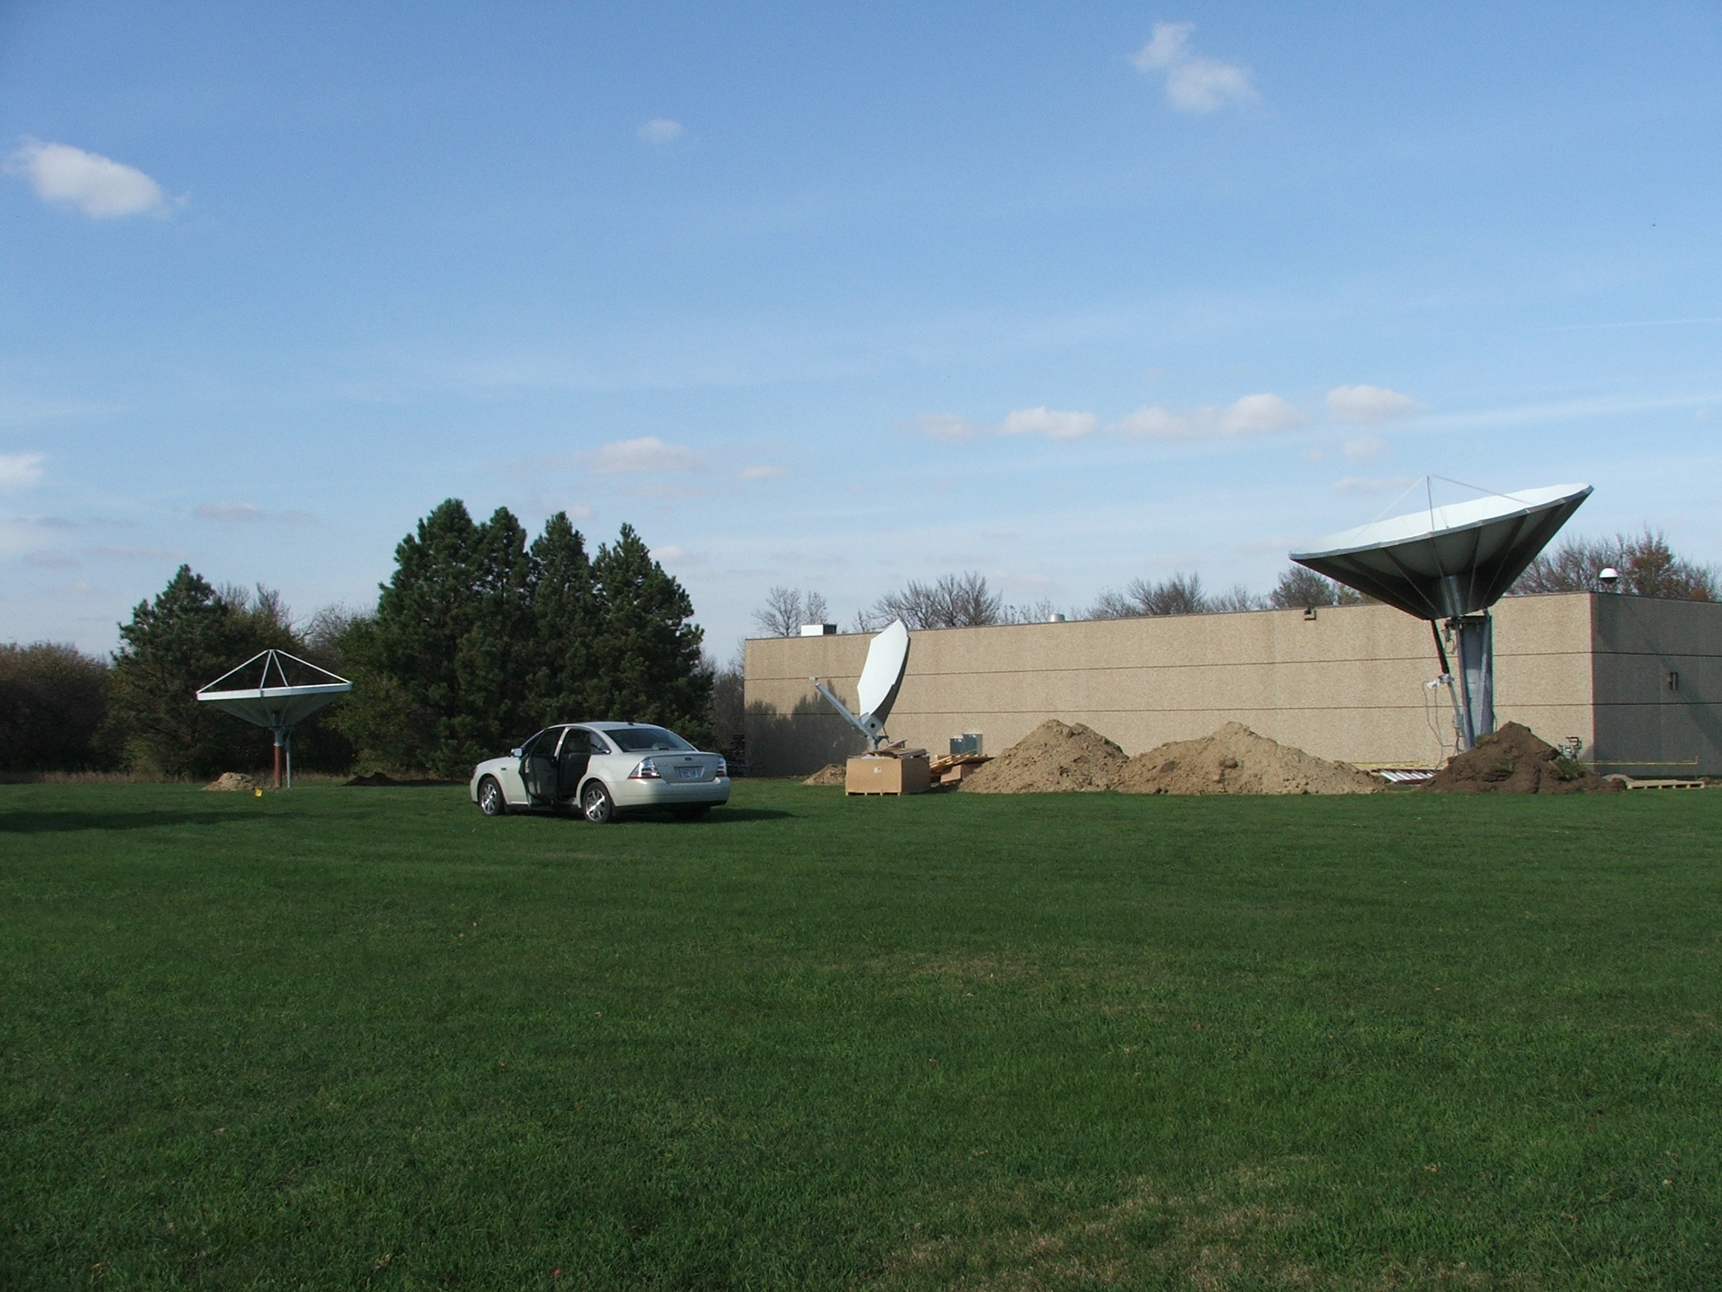
Three New Antennas
(3.8M backup, 2.4M DOMSAT, 7.5M GOES West)

Slide 7
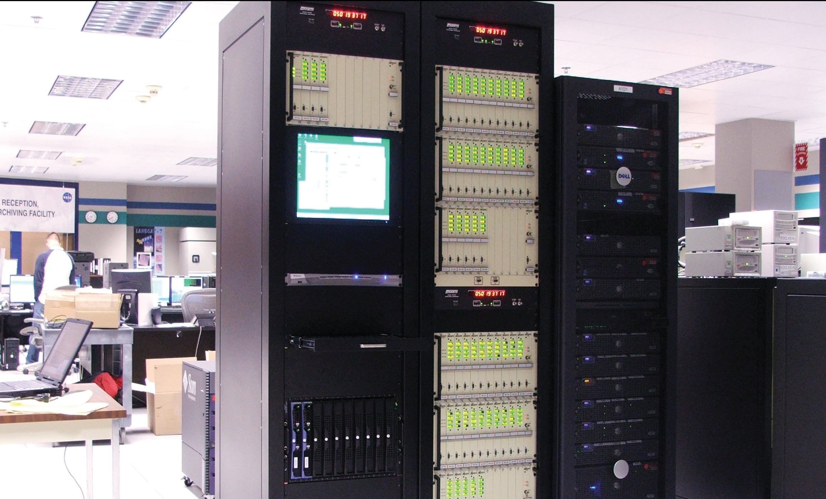
GOES Receive Equipment at EROS

Slide 8
EDDN System Status
EDDN was handed to the USGS in Spring 2008
Issues in the first year of operation:
  Minor wind damage to the 7.5m antenna
    (Did not affect the operation of the antenna)
  Loss of azimuth control of the 7.5m antenna
    (GOES West reception was moved to the backup antenna)
Successfully negotiated two blackout periods
Maintenance option picked up for the next year

Slide 9
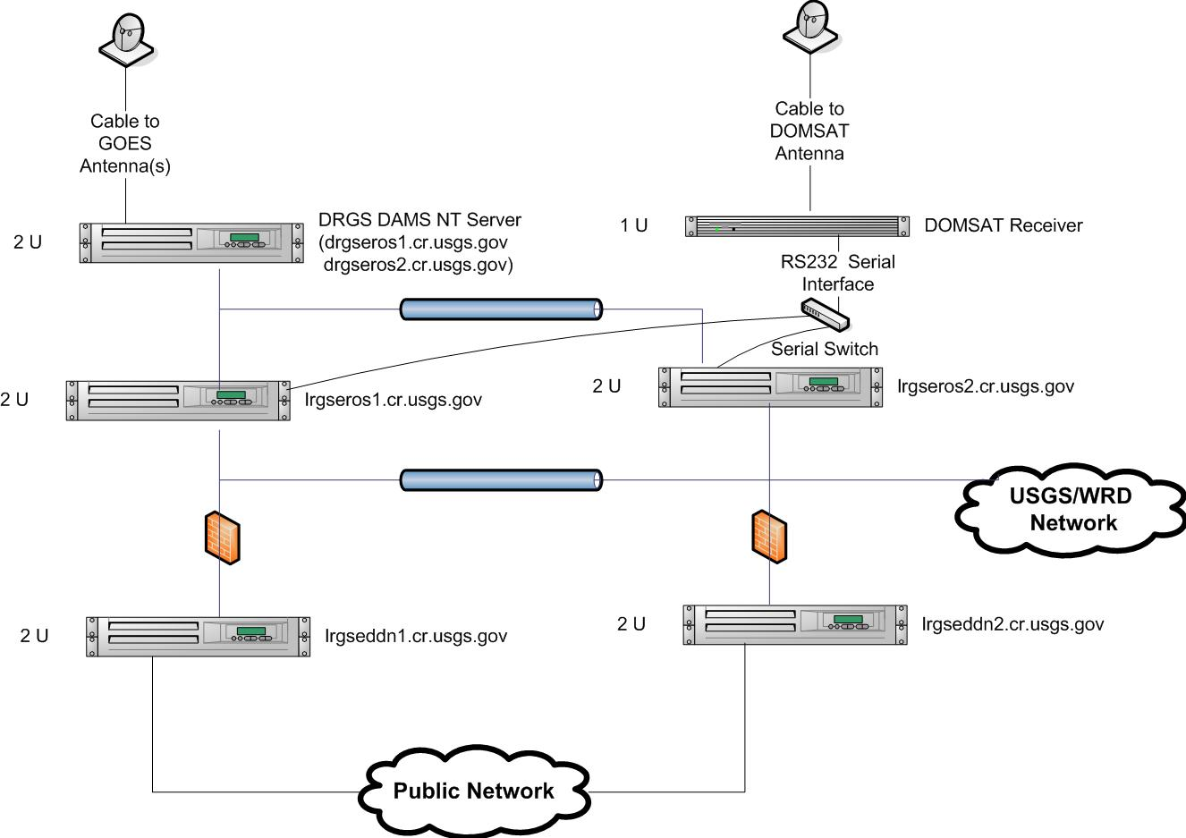
EROS System Diagram

Slide 10
EDDN System Status
USGS EROS LRGSs
  lrgseros1.cr.usgs.gov
  lrgseros2.cr.usgs.gov
Public EROS LRGSs
  lrgseddn1.cr.usgs.gov
  lrgseddn2.cr.usgs.gov

Slide 11
More Information about EDDN at EROS
The EDDN has a public Web page that provides:
    Status of the public Data servers
    Access to a system monitoring page
    Web pages that
      describe the EDDN,
      describe message format of DCP data,
      provide message access services,
      and make available relevant Documentation.
URL is
        http://eddn.usgs.gov

Slide 12
New EDDN Web Services
http://eddn.usgs.gov/msgaccess.html
  Provides a web service similar to msgaccess from the DECODES installation. User can access DCP messages based upon time, address, and channel criteria. (Does not decode the data)
http://eddn.usgs.gov/fieldtest.html
  Provides a low-bandwidth means of publicly accessing messages from a specific DCP. Designed for the access from a cell phone or PDA.

Slide 13
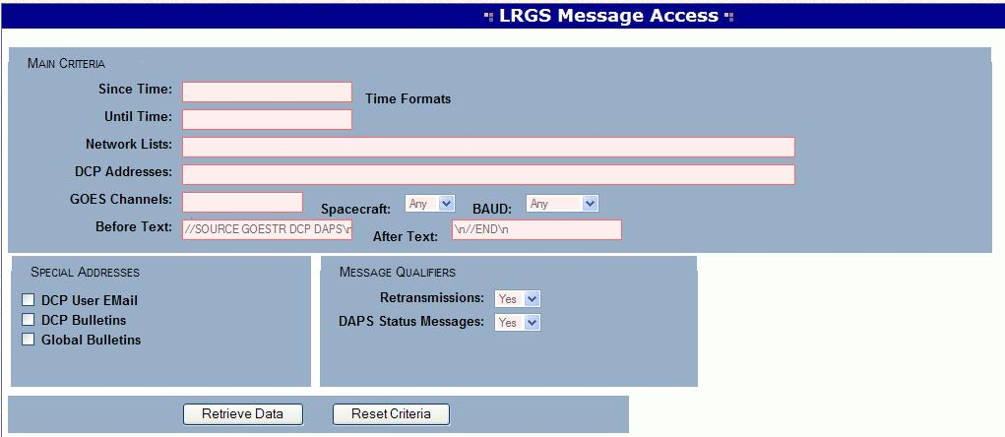
EDDN Message Access

Slide 14
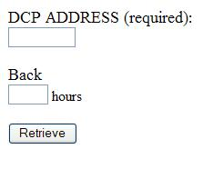
EDDN Field Test Page
Criteria Page
Page Source
<html><head><title>FIELD MESSAGE RETRIEVAL</title><body>
<form action="http://lrgseddn1.cr.usgs.gov/cgi-bin/fieldtest.pl" method="POST">
<p><font size="+1">DCP ADDRESS (required):</font><br>
<input type="text" name="DCPID" size="8"></p>
<p><font size="+1">Back </font><br>
<input type="text" name="SINCE" size="3"> hours</p>
<p><input type="submit" value="Retrieve" name="B1"></p>
</form>
</body></html>
Result Page
EDDN Field Retrieval
DCP: DD29E3F0 From now minus 8 hours until now.
DD29E3F009082065534G42-4NN130WXW000243J@@l@GA@@l@F?@@l@F?zWJ
DD29E3F009082053520G42-4NN130WXW000242E@@l@Fz@@l@Fy@@l@FyzVJ

Slide 15
EDDN Enhancements
Adding demods this summer to accommodate the freed up international channels. (Stimulus money)
Starting a project to make available all the USGS and Corps DECODES platform configurations to the public.
LRGS software upgrade (in coordination with Wallops Island)

